Slide 1


Mobile Apps Design
Postgrado en
FUNDAMENTALS
Juan Luis Gorricho

Slide 2
ANDROID
Application components:
  Activity: An activity provides the user interface usually in the form of a single screen and handles all events triggered from that interface.
  Service: A service is a component that runs in background to perform long-term operations, periodic operations or activities involving remote connections.
  Broadcast receiver: is inactive until the reception of a broadcast message, reacting to the event and executing a given task.
  Content provider: A content provider manages some application data to make it available to other applications.

Slide 3

INTENTS
An Intent object is the communication unit between components of the same or different applications. This is a passive object keeping a data structure with instructions about an operation to be executed.
In any case, the Android OS identifies the activity, service or set of broadcast receivers to receive the intent, instantiating them if necessary.

Slide 4

INTENTS
The Intent object is composed of:
  Component name: naming the receiver component of the intent.
  Action: string of characters indicating the action to be executed.
  Data: the URI address location of the data to work on and the
type (MIME type) of data to be processed.
  Category: complementary to the action, string of characters indicating the type of component which will process the intent.
  Extras: pairs key-value with complementary data.
  Flags: auxiliary flags to warn Android how the receiving component must be executed.

Slide 5
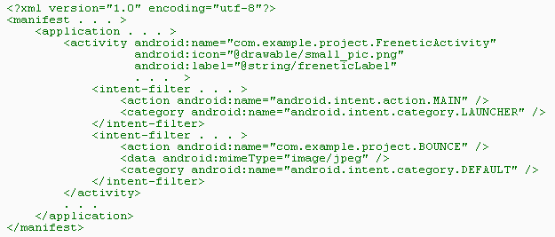
INTENT FILTERS
Declaring intent filters at the manifest file:

Slide 6


STARTING AN ACTIVITY
Creating an Intent with explicit resolution:
Intent myIntent = new Intent( this , Activity2.class ); startActivity(myIntent);
Creating an Intent with implicit resolution:
Intent myIntent = new Intent(); myIntent.setAction("edu.upc.exercise2"); startActivity(myIntent);

Slide 7
ACTIVITIES AND TASKS
Android defines the Task concept or “stack of activities” for a given application.
An activity initiates another one, for example, calling startActivity(intent), being the target activity from the same or another application.
Once a new activity is initiated, on pressing the “back” button we come back to the previous activity.

Slide 8
STARTING TASKS
A task is created on executing an activity with filter action “MAIN” and category “LAUNCHER”, this way the activity is accessible from the desktop apps manager. This is one way to retrieve the task once it has been sent to background, e.g. on pressing the HOME button.
A long-press of the HOME button also provides access to recent apps.
Otherwise, any task sent to background is unreachable.

Slide 9
ACTIVITIES AND TASKS
The task contains a stack of activity objects, objects as instances of different or the same activity. The activities' stack is usually not reordered, so only push and pop operations are commonly used.
A whole task can be brought back to the foreground (user application activated) or sent to background (user activity deactivated), for example, pressing the BACK and HOME buttons.

Slide 10
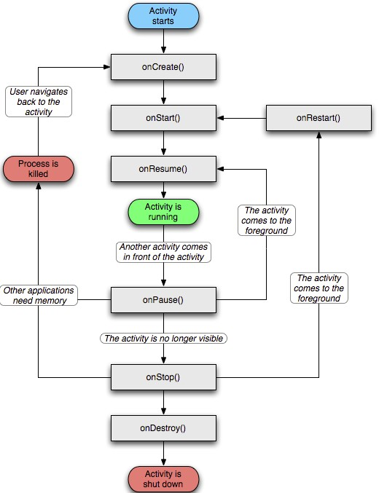
ACTIVITY CYCLE OF LIFE
10

Slide 11
RESOURCES
They are external files used within the code and packed with the application.
The resources must be located within the folder “res” and organized as follows:
  res / drawable / png, jpg, 9.png and gif files
  res / layout / screen layout XML files
  res / values / predefined XML files, see next slide
  Others…
All file names hanging from res must be given in lower- case letters, otherwise you’ll have unexpected errors
11

Slide 12
RESOURCES
res / values /
  arrays.xml to declare arrays.
  colors.xml to declare colors.
  dimens.xml to declare dimensions.
  strings.xml to declare strings of characters.
  styles.xml to declare styles and themes.
  Others…
12

Slide 13
DIMENSIONS
Units to define dimensions:
  dp, dip: density-independent pixels. These units are relative to a 160 dpi (dots per inch) screen
  sp: scale-independent pixels: dip + scaled by the user's font size preference
  pt: points (1/72 of an inch)
  px: pixels
  mm: millimeters
  in: inches

Slide 14
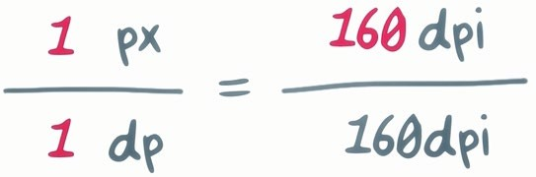
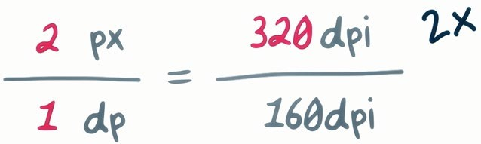
DIMENSION

